Slide 1
Linear Discriminant Analysis

Slide 2
The Problem
We’ve got a cancer drug:
It works great for some people
But it makes other people feel worse
How do we decide who to give the drug to
Maybe gene expression can help us decide

Slide 3
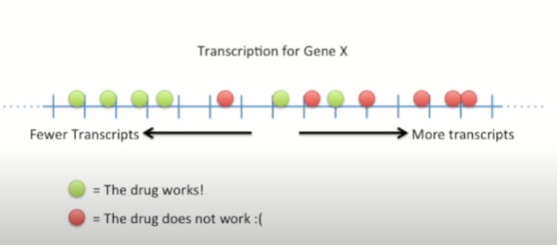
Using one gene to decide

Slide 4
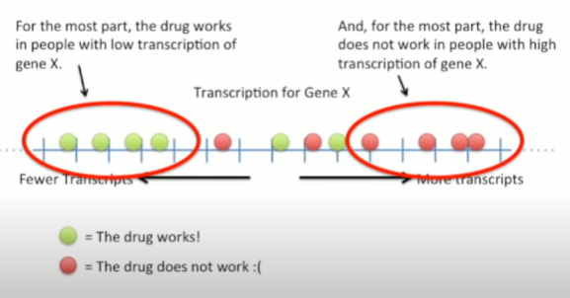
Using one gene to decide

Slide 5
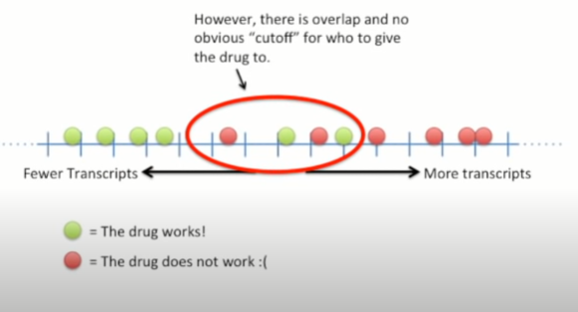
Using one gene to decide

Slide 6
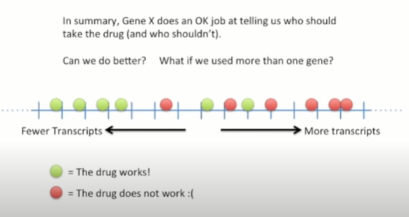
Using one gene to decide

Slide 7
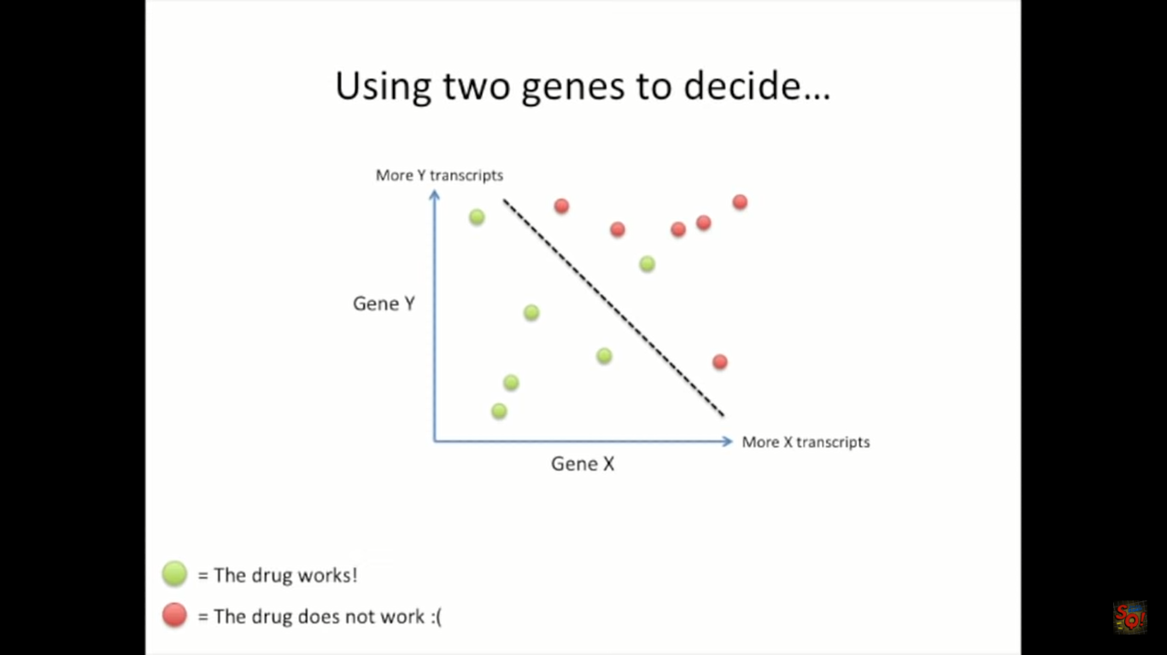
Using two genes to decide

Slide 8
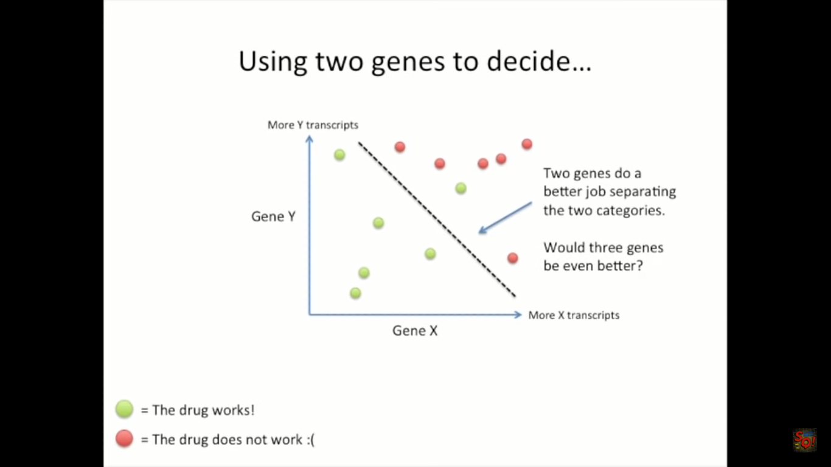
Using two genes to decide

Slide 9
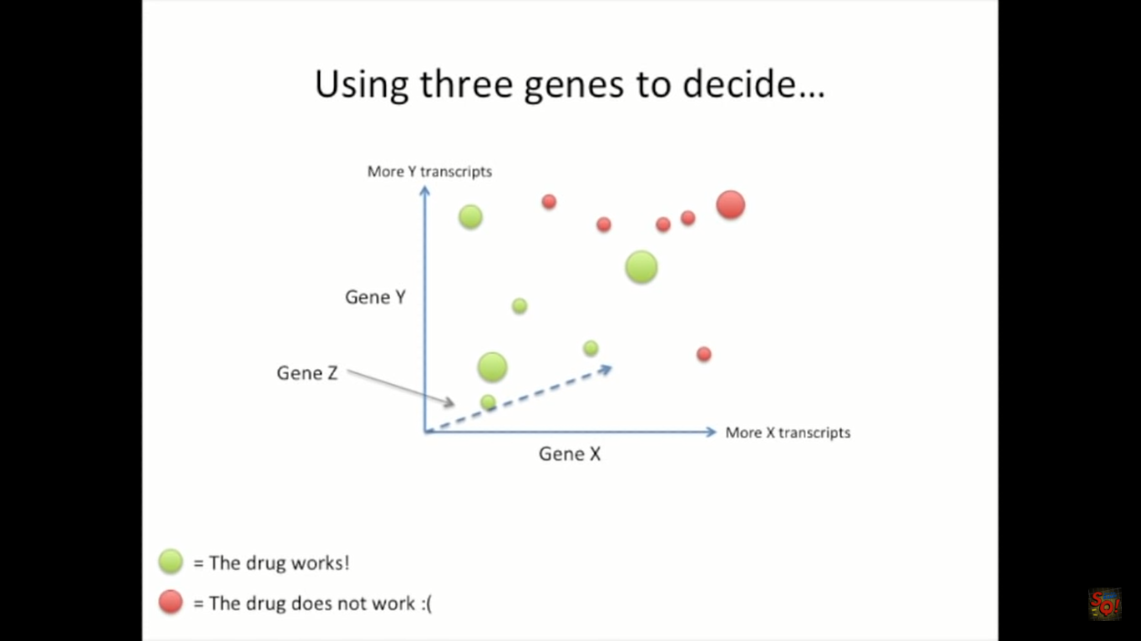
Using three genes to decide

Slide 10
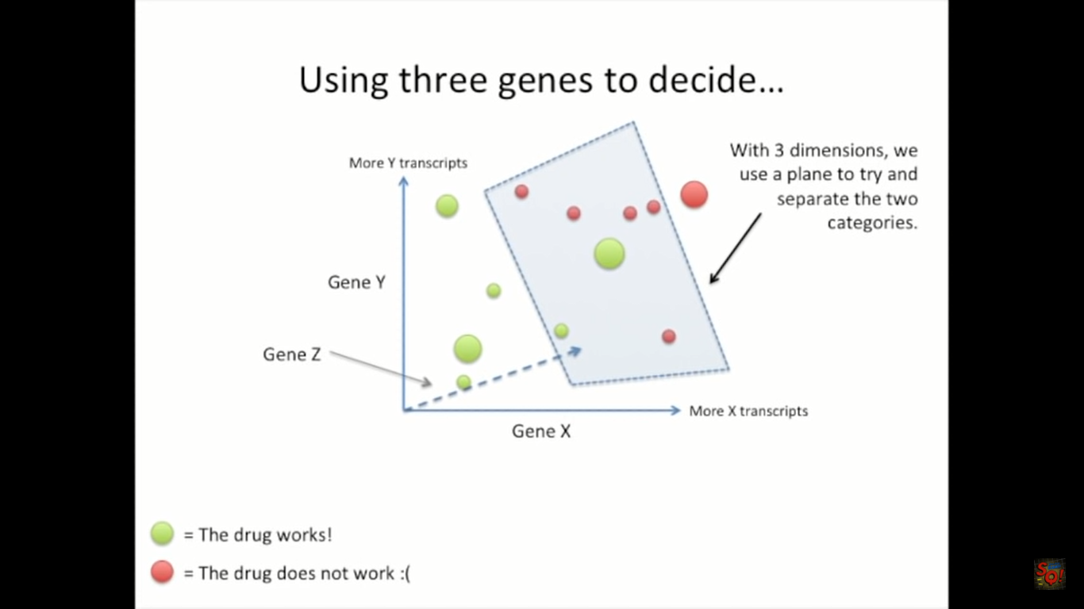
Using three genes to decide

Slide 11
What if we need four genes to separate two categories?

Slide 12
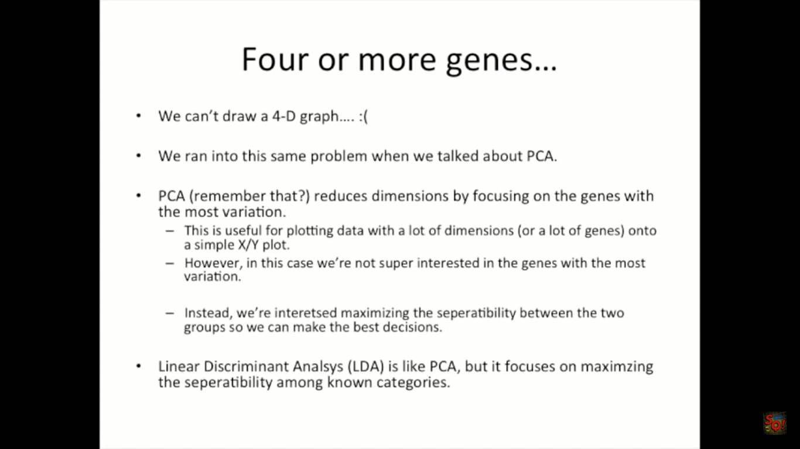
Four or more genes

Slide 13
LDA is like PCA but it focuses on maximizing the seperatibility among known categories

Slide 14
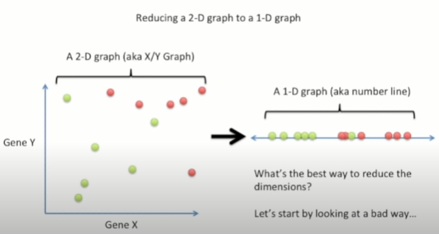
Simple example

Slide 15
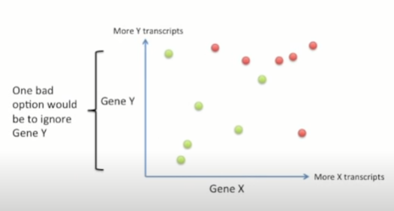
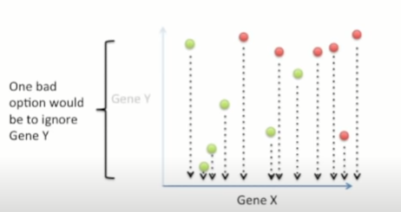
Reducing a 2-D Graph to 1-D Graph

Slide 16
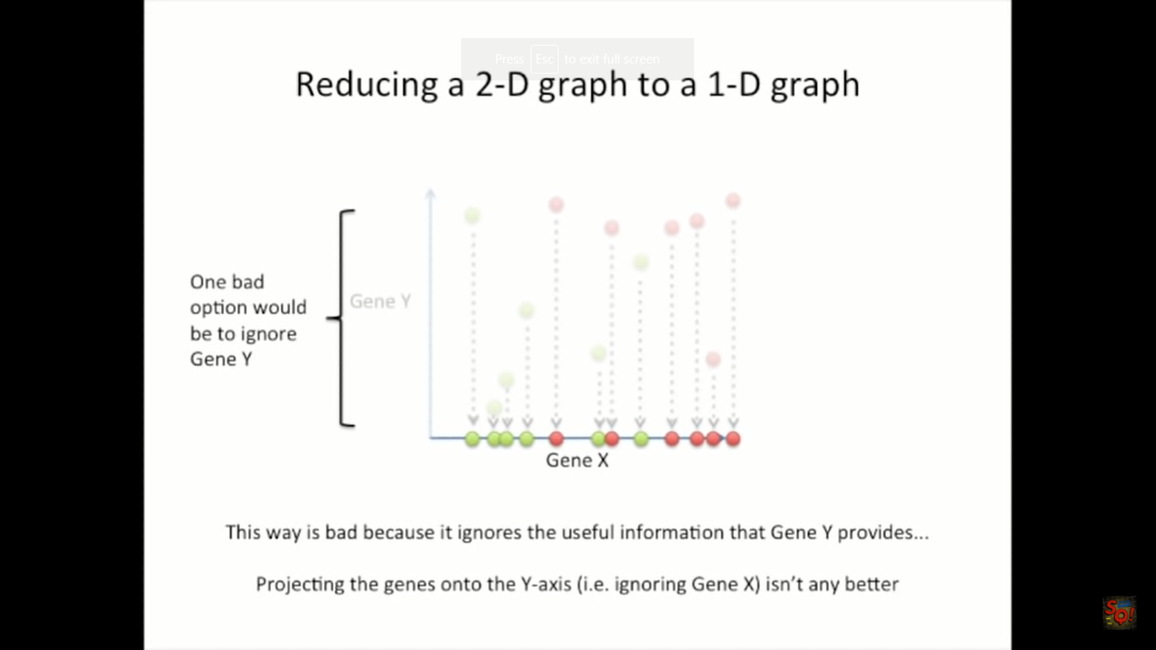
Reducing a 2-D Graph to 1-D Graph

Slide 17
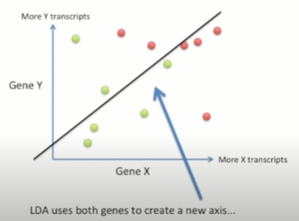
LDA Provides a better way
Notes:
P() probability distribution

Slide 18
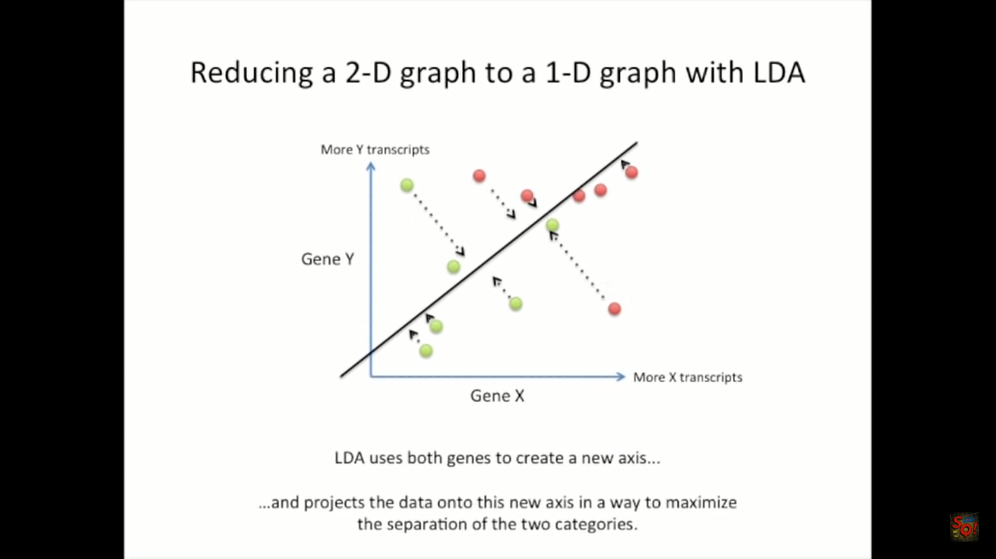
LDA Provides a better way
Notes:
P() probability distribution

Slide 19

LDA Provides a better way
Notes:
P() probability distribution

Slide 20
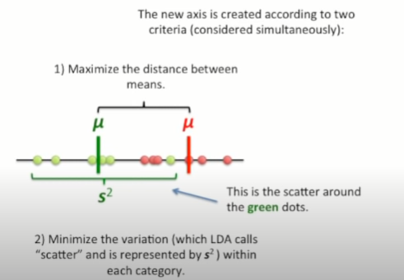
How LDA creates new axis?
Notes:
P() probability distribution

Slide 21
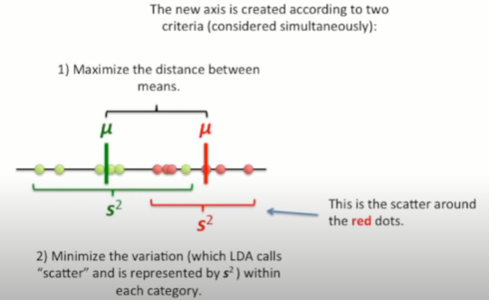
How LDA creates new axis?
Notes:
P() probability distribution

Slide 22
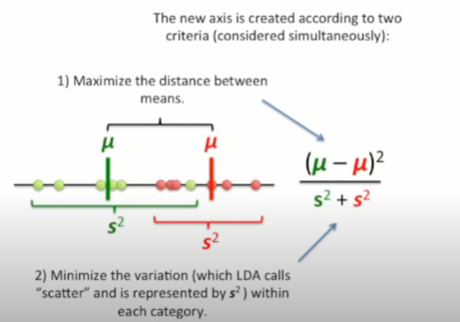
How LDA creates new axis?
Notes:
P() probability distribution

Slide 23
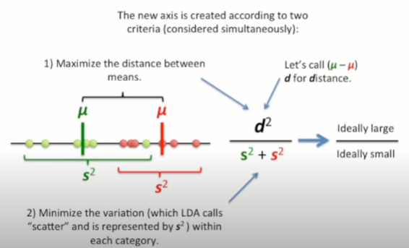
How LDA creates new axis?
Notes:
P() probability distribution

Slide 24
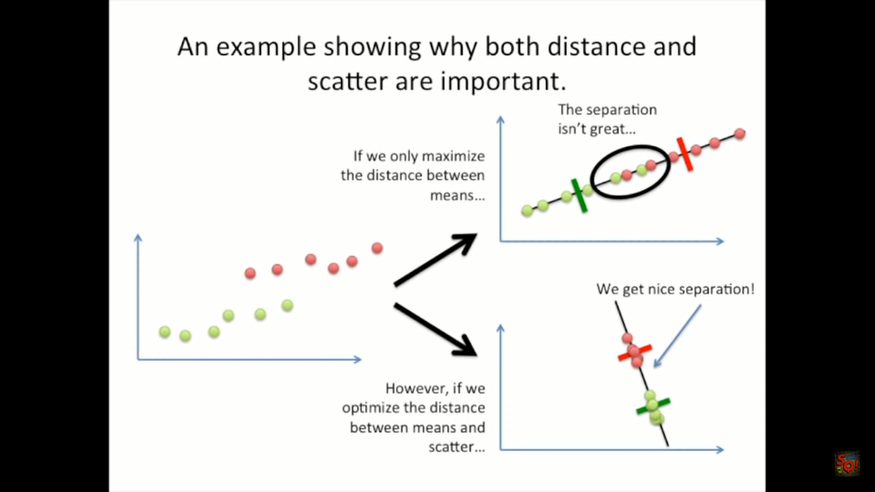
Example showing why both distance and scatter are important
Notes:
P() probability distribution

Slide 25
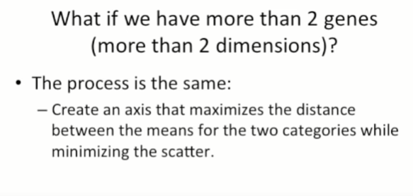
Notes:
P() probability distribution

Slide 26
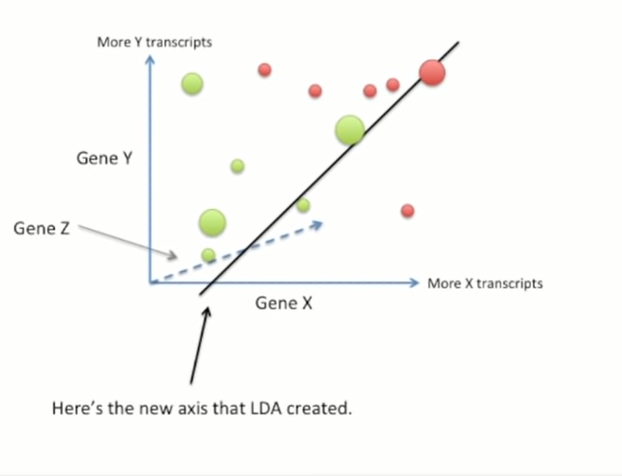
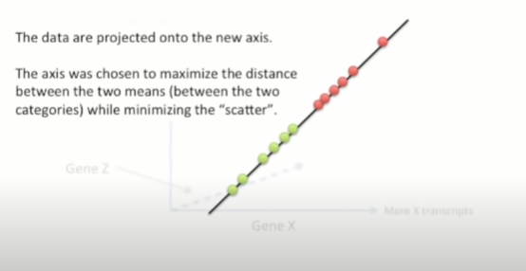
LDA with 3 Genes
Notes:
P() probability distribution

Slide 27
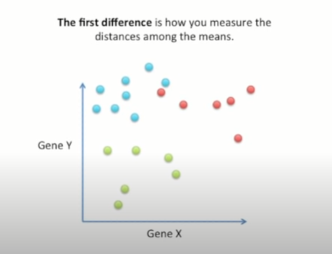
LDA For 3 categories
Notes:
P() probability distribution

Slide 28
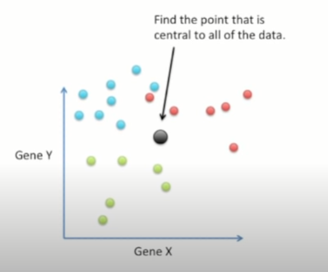
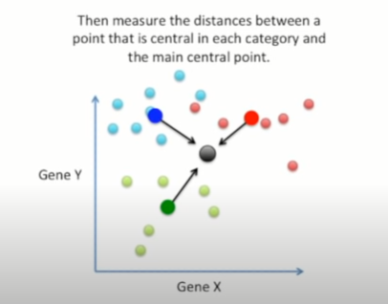
LDA For 3 categories
Notes:
P() probability distribution

Slide 29
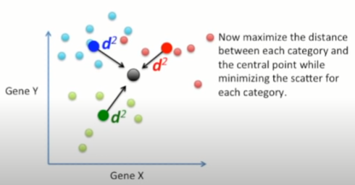
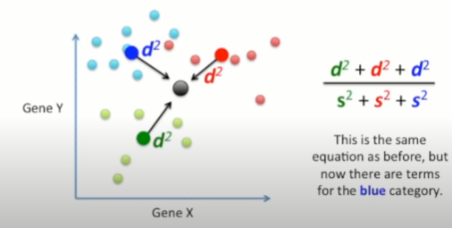
LDA For 3 categories
Notes:
P() probability distribution

Slide 30
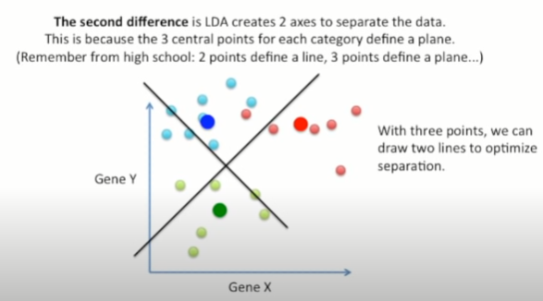
LDA For 3 categories
Notes:
P() probability distribution

Slide 31
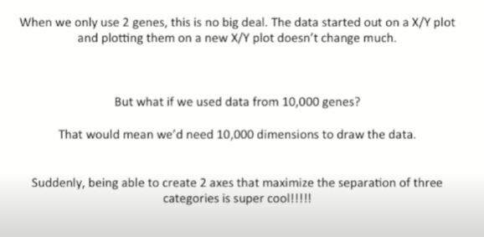
LDA For 3 categories
Notes:
P() probability distribution

Slide 32
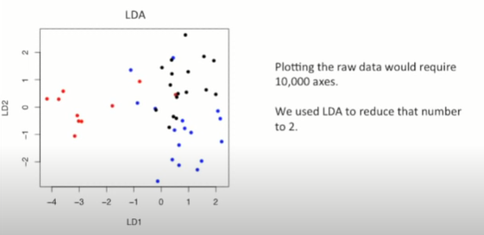
LDA For 3 categories and 1000 genes
Notes:
P() probability distribution

Slide 33
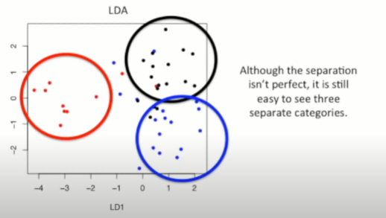
LDA For 3 categories and 1000 genes
Notes:
P() probability distribution

Slide 34
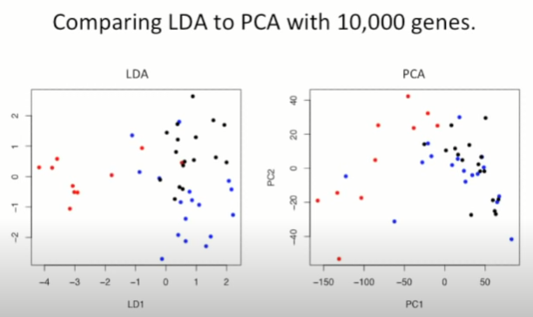
Comaring LDA to PCA
Notes:
P() probability distribution

Slide 35
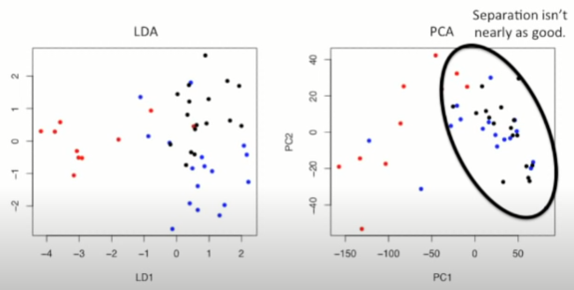
Comaring LDA to PCA
Notes:
P() probability distribution

Slide 36
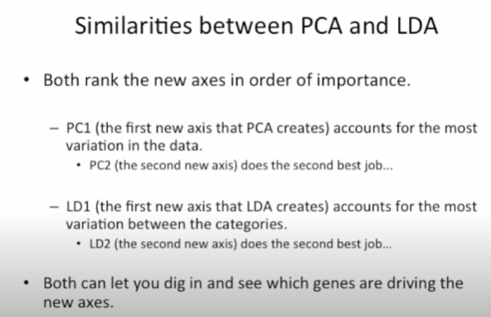
Similarities between LDA to PCA
Notes:
P() probability distribution

Slide 37
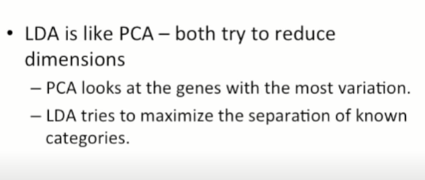
Summary
Notes:
P() probability distribution

Slide 38
References https://www.youtube.com/watch?v=azXCzI57Yfc

Slide 39
Thank You

